Slide 1
Machine Learning Project
Dataset-Diabetes

Slide 2
Outline :
Data Description
Data Exploration.
Data Visualization.
Data Pre-processing.
Feature selection.
Data Splitting & Training.
Fit Model
1] Point estimator’s.
2] Range estimators.
3] Describe estimators.
Results.
Conclusion
Aim

Slide 3
Aim:
The objective is to predict based on diagnostic measurements whether a patient has diabetes. italicized text

Slide 4
Description: Several constraints were placed on the selection of these instances from a larger database. In particular, all patients here are females at least 21 years old of Pima Indian heritage.
Pregnancies: Number of times pregnant
Glucose: Plasma glucose concentration a 2 hours in an oral glucose tolerance test.
Blood Pressure: Diastolic blood pressure (mm Hg).
Skin Thickness: Triceps skin fold thickness (mm).
Insulin: 2-Hour serum insulin (mu U/ml).
BMI: Body mass index (weight in kg/(height in m)^2).
Diabetes Pedigree Function: Diabetes pedigree function.
Age: Age (years)
Outcome: Class variable (0 or 1)

Slide 5
import pandas as pd
import matplotlib.pyplot as plt
import seaborn as sns
import numpy as np

Slide 6
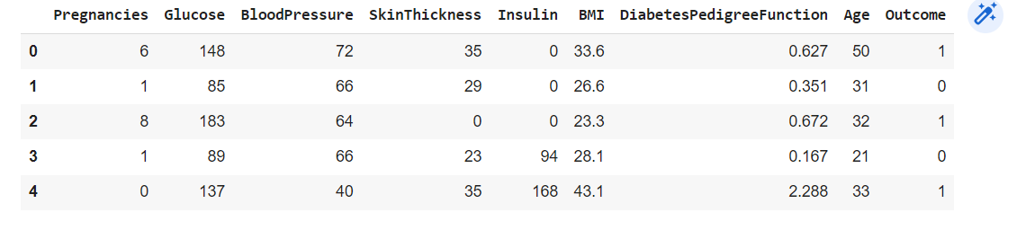
data.head()

Slide 7
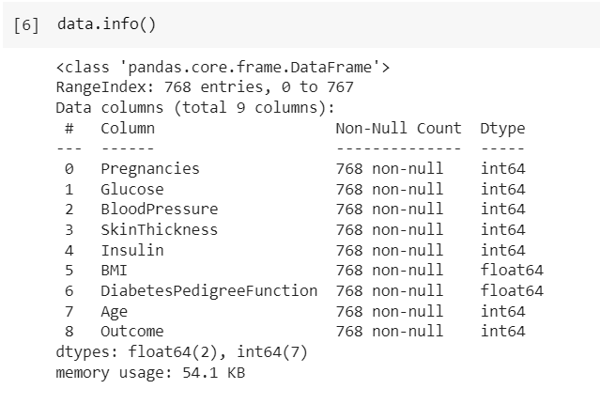
Data.info()

Slide 8
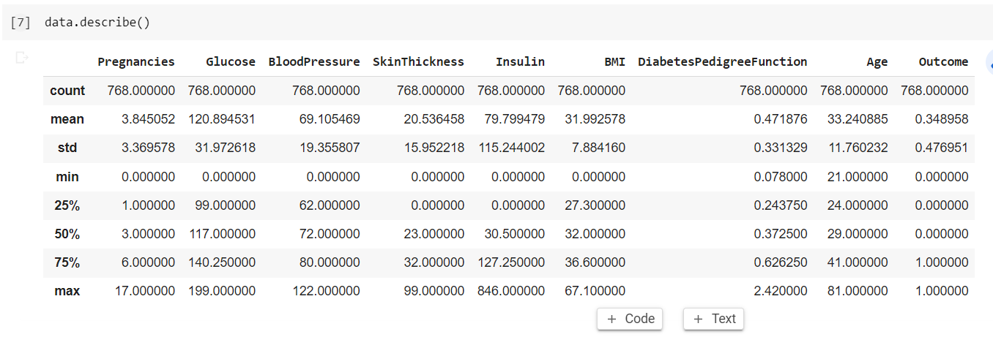
Data.describe()

Slide 9
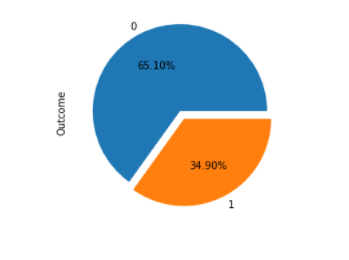
Visualization:
So we have a biased data.
we need to apply stratify sampling .

Slide 10
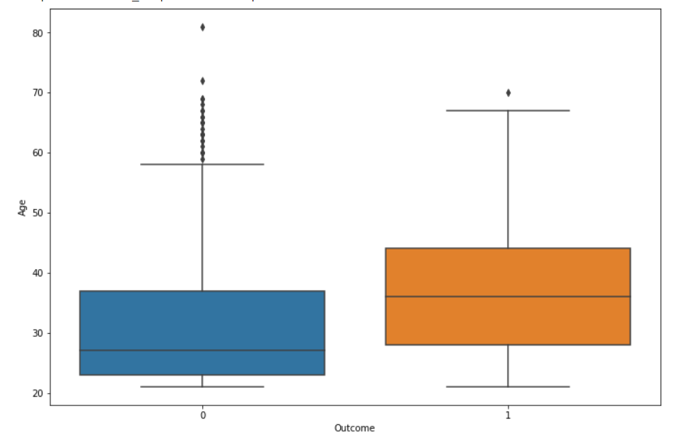
Outliers:

Slide 11
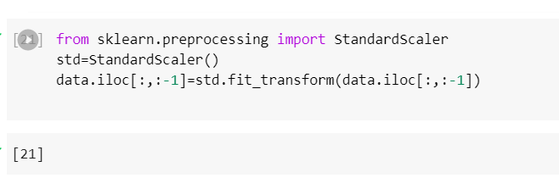
Data pre-processing:

Slide 12
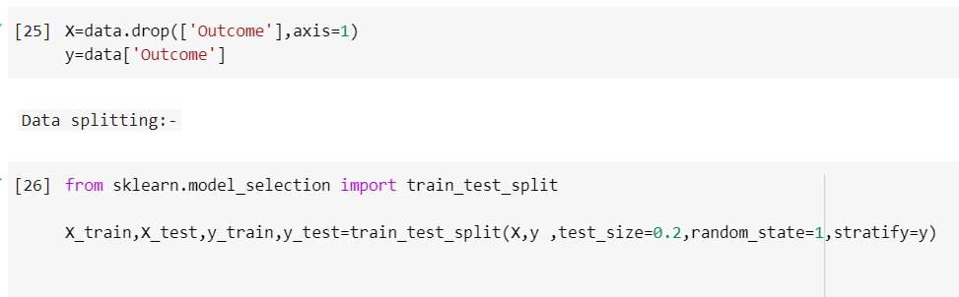
Feature selection & data splitting:

Slide 13
Approach:
Fit Model
Point estimator’s : Logistic-Regression
Range estimators : Support-Vector- Classifiers.
Descriptive estimators :
Decision Tree ,Random Forest

Slide 14
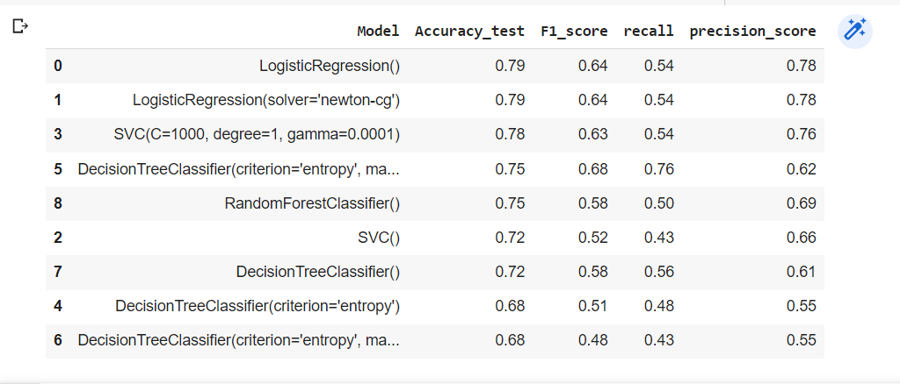
Result:

Slide 15
Conclusion:
By comparing all the results we got highest 79% accuracy. with f1_score 64.
By applying all estimators we conclude that Logistic regression is giving a good result. (binary)

